Slide 1

Faculty of Science & Technology
Jagran School of Computer Application
Major Project Presentation
Personal Finance Manager
Under the Supervision of:
Mr. Yugansh Garg
Asst. Prof., Dept. of CSE,
JLU-FAST
Presented by:
Zuhair Islam Jafri(2023BCAH063)

Slide 2
Outline
Introduction
Importance and Need of Your Project
Contribution & Role of Team Members
Features of your Project
Uniqueness of Project
Comparison with existing systems
Tools and Technologies
System/User requirements
Diagrams
Snapshots of the system
Conclusion
Future work

Slide 3
Introduction
Manstudents and professionals.
Existing apps are complex or require continuous internet access.
aging personal finance effectively is challenging for This app helps users record, analyze, and visualize income/expenses efficiently.
Focused on privacy, simplicity, and offline data management using JSON.

Slide 4
Importance & Need of Your Project
Many people struggle to track and manage their spending habits.
Most existing finance apps demand sign-ups and online sync.
Need for an easy, secure, and offline-friendly tracker.
Useful for students, families, freelancers, and self-employed individuals.

Slide 5
Features of your Project
Add, edit, and delete income and expense transactions.
Category-wise visualization using Chart.js.
Local data storage using JSON with option for SQL/NoSQL integration.
Responsive interface designed with Bootstrap.
Budget goal tracking and monthly summary alerts.

Slide 6
Uniquenes of Project
Real-time budget alerts.
Data visualization.
Personalized reports.
Financial awareness.
Automated Tracking.

Slide 7
Comparison with Existing Systems
Manual tracking → boring, not real-time.
Other apps → limited, lack budget alerts/personalization.
Our app → Real-time tracking + Alerts + Reports + Easy UI.

Slide 8
Tools and Technologies
Frontend: HTML, CSS, JavaScript
Database: JSON (local) – supports SQL/NoSQL integration
Libraries: Chart.js, Bootstrap
Development Environment: Visual Studio Code, GitHub
Testing & Debugging: Browser Developer Tools

Slide 9
System/User requirements
OS: Windows, Linux, or macOS
Browser: Chrome, Edge, or Firefox
Node.js Runtime Environment installed
Internet: Only for setup and GitHub sync
Basic finance understanding for end-users

Slide 10
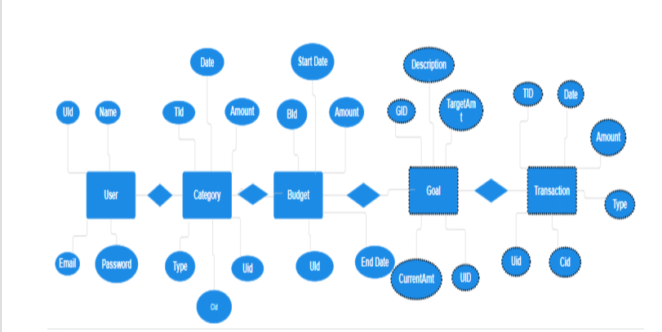
Diagrams
ER Diagram

Slide 11
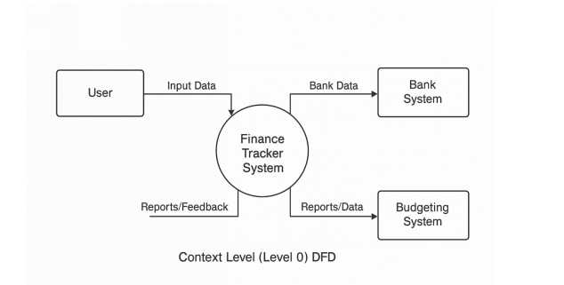
Diagrams
LEVEL 0 DATA FLOW DIAGRAM

Slide 12
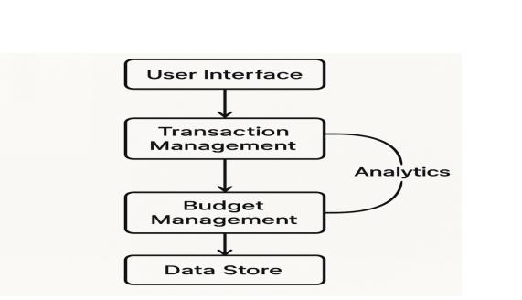
Diagrams
Level 1 Data Flow Diagram (DFD)

Slide 13
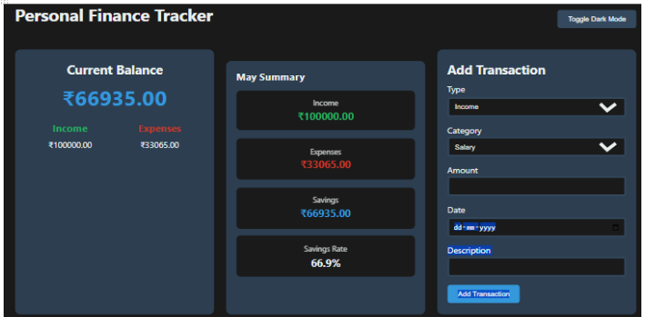
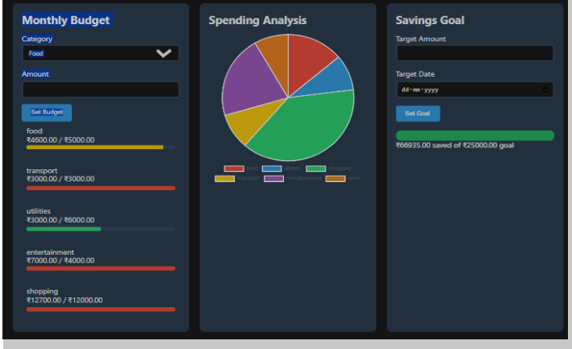
Snapshots of system

Slide 14
Conclusion
Provides a Centralized , User friendly App.
Helps in tracking, analyzing, and optimizing finances.
Encourages savings & prevents overspending.
Scalable & practical solution for personal finance.
Helps Users Manage Money Efficiently.
Helps in Develop Saving Habits .

Slide 15
Refrences
[1] Mozilla Developer Network (MDN) Web Docs. (2025). HTML CSS and JavaScript Documentation. Retrieved from https://developer.mozilla.org/ (Accessed on 15 october 2025)
[2] W3Schools. (2025). JavaScript, HTML, CSS Tutorials and References. Retrieved from https://www.w3schools.com/ (Accessed on 17 october 2025)
[3] Bootstrap (2025). Bootstrap Documentation, Retrieved from https://getbootstrap.com/ (Accessed on 18 October 2025)
[4] Chart.js (2025). Simple, yet flexible JavaScript charting for designers & developers. Retrieved from https://www.charts.org/ (Accessed on 21 October 2025)
[5] Stack Overflow (2025). Coding Solutions and Developer Community, Retrieved from https://stackoverflow.com/ (Accessed on 25october 2025)
[6] Google Fonts (2025) Web Fonts and Typography Retrieved from https://fonts google.com/ (Accessed on 30 October 2025)
[7] Free Code Camp (2025). Responsive Web Design and JavaScript Algorithms. Retrieved from https://www.freecodecamp.org/ (Accessed on 2 November2025)
[8] JS0N.org. (2025) JavaScript Object Notation (ISON) Documentation. Retrieved from https://www.json.org/ ( Accessed on 4 November 2025)
[9] LocalStorage API Web APIs | MDN (2025). Using the LocalStorage API for Data Persistence Retrieved from https://developer.mozilla.org/en-US/docs/Web/API/Window/localStorage (Accessed on 6 November 2025)

Slide 16
APPENDICES(include Github Repository Link)
https://github.com/zuhairislam1234/Personal-Finance-Manager.git

